Slide 1
Intro to Application and Cloud Security

Slide 2
Why?
1 in 10 small businesses suffers a cyberattack each year.
60% of small businesses go out of business after being victims of a cyber attack.
The USA had 759% more victims of cyber crime in 2021 than the next-highest country, Canada.
98% of web applications are vulnerable to attacks that can result in malware, redirection to malicious websites and more.
72% of vulnerabilities were due to flaws in web application coding

Slide 3
Story
Competitor to Galileo Processing
Phishing email
Access to the DB
Cloned thousands of CC #s
Removed millions of dollars from ATMs
No recovery

Slide 4
Heartland Payment Systems
Heartland Payment Systems, which processed payment card transactions for 175,000 merchants, was breached via SQL injection. Both Visa and Mastercard notified the company, and it was subsequently banned from processing payments of major credit card providers for 14 months following the discovery. They also paid out approximately $145 million in compensation.

Slide 5
Main Concepts
Vulnerability
Attack Vectors
Exploit or Attack
Attack surface
Firewalls and VPCs
OWASP top 10

Slide 6
Vulnerability
Despite intentions to achieve complete correctness, virtually all hardware and software contains bugs where the system does not behave as expected. If the bug could enable an attacker to compromise the confidentiality, integrity, or availability of system resources, it is called a vulnerability.
Examples:
Broken Input validation
Bocken Access control
Improper Exception handling
Misconfiguration
A race condition—when timing or other external factors change the outcome and lead to inconsistent or unpredictable results

Slide 7
Exploit
An exploit is a tool or technique used to take advantage of a flaw in a system for personal gain. It can be software, data, or a series of commands that leverage a bug or vulnerability in software, hardware, or other electronic systems, typically computerized.
Examples:
SQL Injection
Denial of Service (DoS)
Cross-Site Scripting
Privilege Escalation
Man-in-the-Middle

Slide 8
Attack vectors
A method or path that hackers use to gain unauthorized access to a computer, network, or system to exploit vulnerabilities. An exploit is a sequence of commands that target a specific vulnerability in a system or application to gain access.
Examples
Phishing Emails: Deceptive emails designed to trick users into providing sensitive information or downloading malware.
Unpatched Software: Vulnerabilities in outdated software that can be exploited by attackers.
Weak Passwords: Easily guessable or default passwords that attackers can use to gain access.
Misconfigured Security Settings: Inadequate security configurations that expose the system to attacks.
Publicly Exposed APIs: APIs that are not properly secured, allowing unauthorized access.

Slide 9
Attack surface
The total number of points (attack vectors) where an unauthorized user can try to enter or extract data from an environment. It encompasses all the potential vulnerabilities that could be exploited by an attacker to gain unauthorized access, disrupt operations, or steal data.
Examples:
Web Applications: Includes web forms, URLs, and APIs that might be exposed to external users.
Network Services: Open ports, running services, and communication protocols that can be accessed over a network.
Endpoints: Devices such as computers, smartphones, and IoT devices connected to the network.
Remote Access Points: VPNs, remote desktops, and other tools that allow remote connectivity.
Cloud Services: Cloud-based storage, applications, and infrastructure that can be accessed via the internet.
Software and Libraries: Third-party libraries, plugins, and dependencies that are integrated into applications.

Slide 10
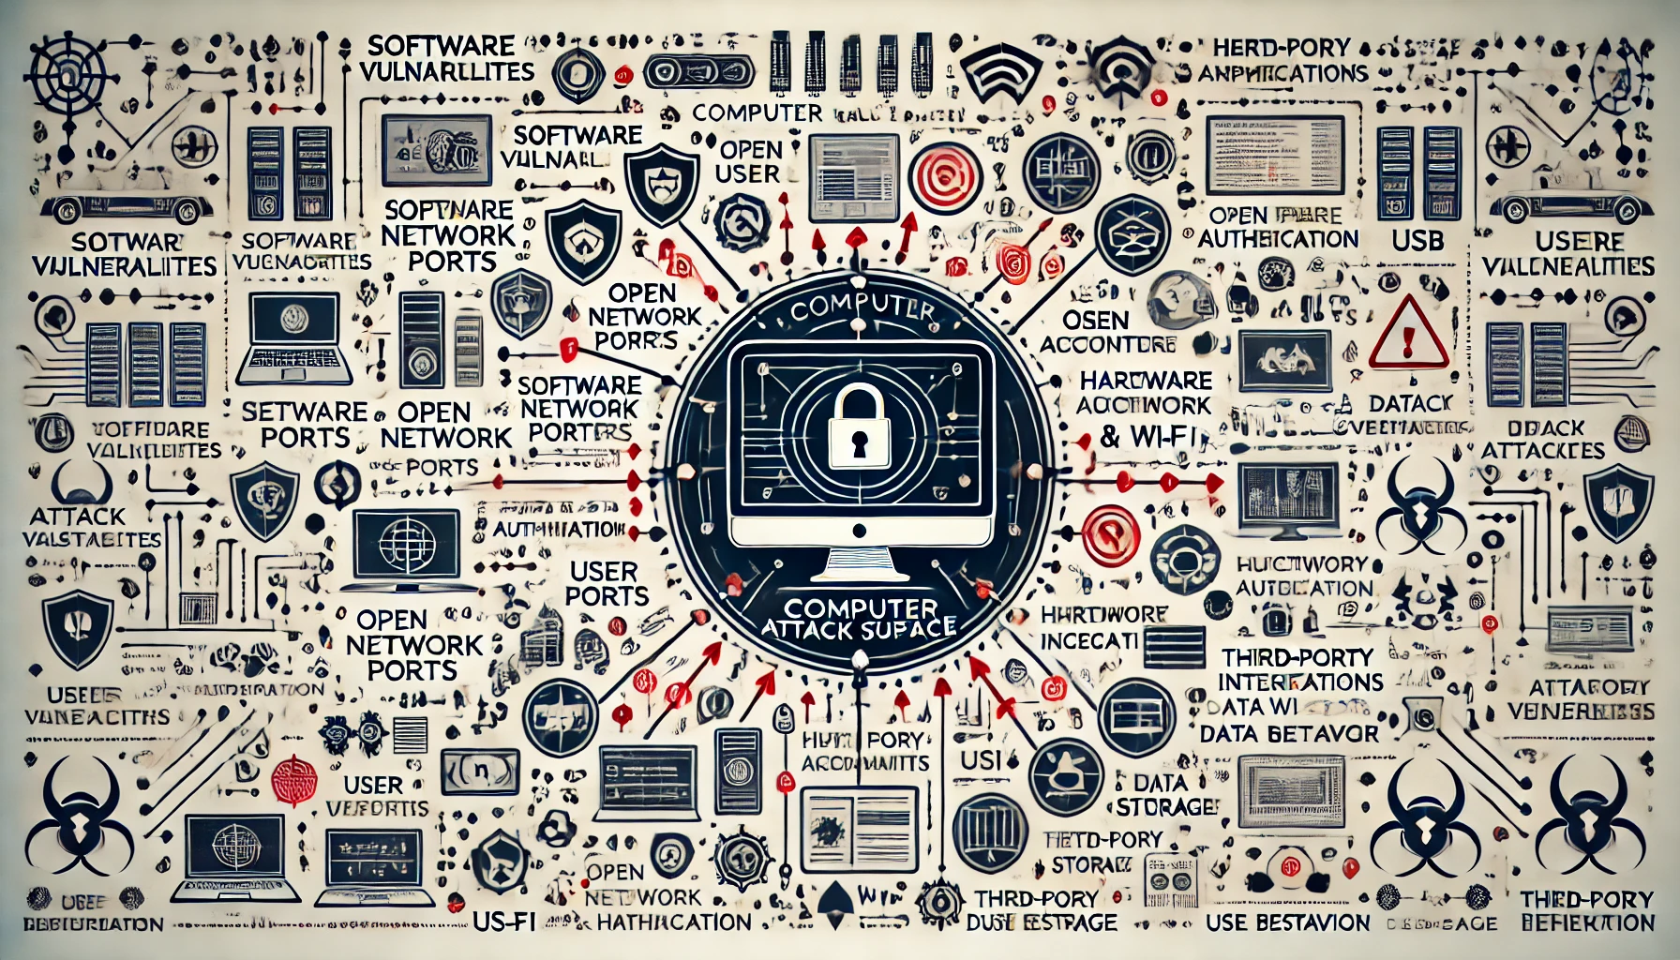

Slide 11
Attack surface (Continued)
Physical Attack Surface:
Hardware: Physical devices such as servers, workstations, and network devices.
Peripheral Devices: USB drives, external hard drives, and other devices that can be connected to the system.
Facilities: Data centers, office spaces, and any location where hardware is stored.
Human Attack Surface:
Employees and Contractors: Potential insider threats, both malicious and accidental.
Social Engineering: Techniques like phishing that trick individuals into divulging sensitive information or granting access.

Slide 12
Questions?

Slide 13

Firewalls
Firewalls are security devices or software applications that monitor and control incoming and outgoing network traffic based on predetermined security rules. They act as a barrier between trusted internal networks and untrusted external networks, such as the internet.
Examples:
Hardware Firewalls: Physical devices that filter traffic between networks.
Software Firewalls: Applications installed on individual devices to control traffic to and from those devices.

Slide 14
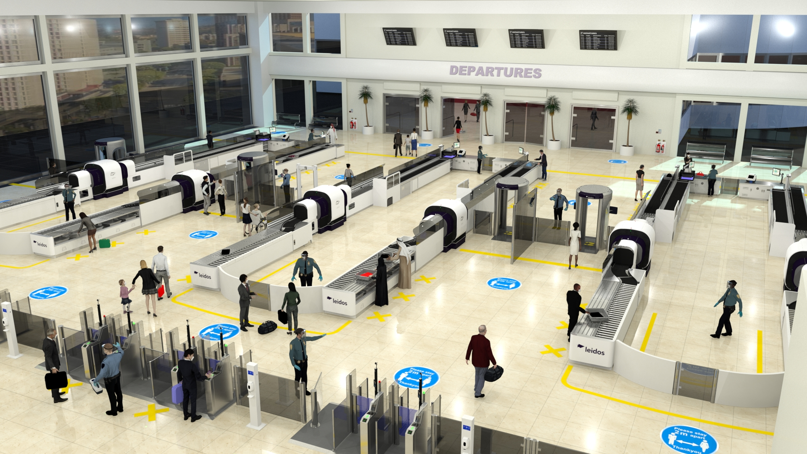
Firewall - Maybe a better analogy

Slide 15
Virtual Private Clouds (VPCs)
Virtual Private Clouds (VPCs) are isolated virtual networks within a public cloud infrastructure. They provide a private environment where organizations can deploy resources like virtual machines (VMs), storage, and databases, with control over network configuration and security.
Benefits:
Isolation: VPCs provide logical isolation from other virtual networks in the same cloud, ensuring secure and private communication.
Subnetting: VPCs can be divided into subnets, allowing segmentation of network resources for better organization and security.
Customizable Network Configuration: Users can configure IP address ranges, route tables, and network gateways.
Security Controls: Security groups and network access control lists (ACLs) to control inbound and outbound traffic at the instance and subnet levels.
Elasticity: Resources in a VPC can be scaled up or down according to demand, offering flexibility and cost efficiency.

Slide 16
Questions?

Slide 17
General Guidelines
Least privilege or deny by default
Never trust input, even if it comes from you.
Bill Joy and the letter k
URL parameters
Form Inputs
API posts
If it’s on the browser (front end code) it is visible by everyone.
Mask sensitive information on output
Outputs derived from inputs should not be executable. “Escape” output
Never share credentials
Never keep credentials in code

Slide 18
The Open Worldwide Application Security Project (OWASP)
OWASP is a nonprofit foundation that works to improve the security of software. Our programming includes:
Community-led open source projects including code, documentation, and standards
Over 250+ local chapters worldwide
Tens of thousands of members
Industry-leading educational and training conferences

Slide 19
OWASP top 10
The OWASP Top 10 represents the most critical security risks to web applications. Protecting against these risks requires a combination of secure coding practices, robust security controls, and ongoing vigilance.

Slide 20
Owasp top 10
Broken Access Control
Cryptographic Failures (Sensitive Data Exposure)
Injection and Cross-site Scripting
Insecure Design
Security Misconfiguration
Vulnerable and Outdated Components
Identification and Authentication Failures
Software and Data Integrity Failures
Security Logging and Monitoring Failures
Server-Side Request Forgery

